Slide 1
MazeRouter Project
Abdelrahman A Yehia 900161280
Dareen Hussein 900170917
Marwa Sulaiman 900172284

Slide 2
A* Algorithm
This algorithm is a graph traversal algorithm. It is defined by the function f = g + h where g is the distance taken from the source to the current cell, and h is the heuristic function which returns the distance between the current and the target cell.
The manhattan version of the heuristic function was used. h = abs (current_cell.x – goal.x) + abs (current_cell.y – goal.y). However, it was modified to take the costs of moving between layers, adding the via count and cost to the heuristic.

Slide 3
Implementation
Code is written in Python programming language.
The flow of the code:
The input file is read and translated
A 3d grid of type Cell (a class created to represent the cell and its attributes) is created
For every net, the pins are sorted by their Layer, and every pin is connected to the one after it.
The function FindPath takes the coordinates of two pins (the source and target) and uses the functions f=g+h to find the best path
5. Finding the path is done by moving step by step from the start cell to the end cell. For each step, all the possible next cells/children are checked and the function f is calculated for each. The cell that gives the minimum value is the one we proceed with.

Slide 4
Implementation Cont’d
6. In case all possible children are used/lead to blocked road, the function takes one step back.
7. When we reach the target cell, the function returns the taken path throughout the process
8. The paths between the pins are concatenated to form the path for the net as a whole.
9. The paths taken for all nets are written to output file and displayed in a 3d interactive representation.

Slide 5



Sample Inputs
The input is read from a text file with the connections in forms of:
Net_name = (pin1layer, pin1x, pin1y) (pin2layer, pin2x, pin2y)

Slide 6
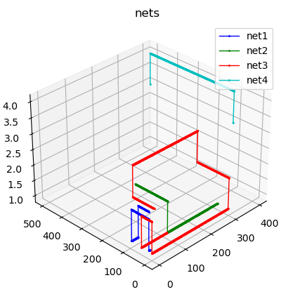
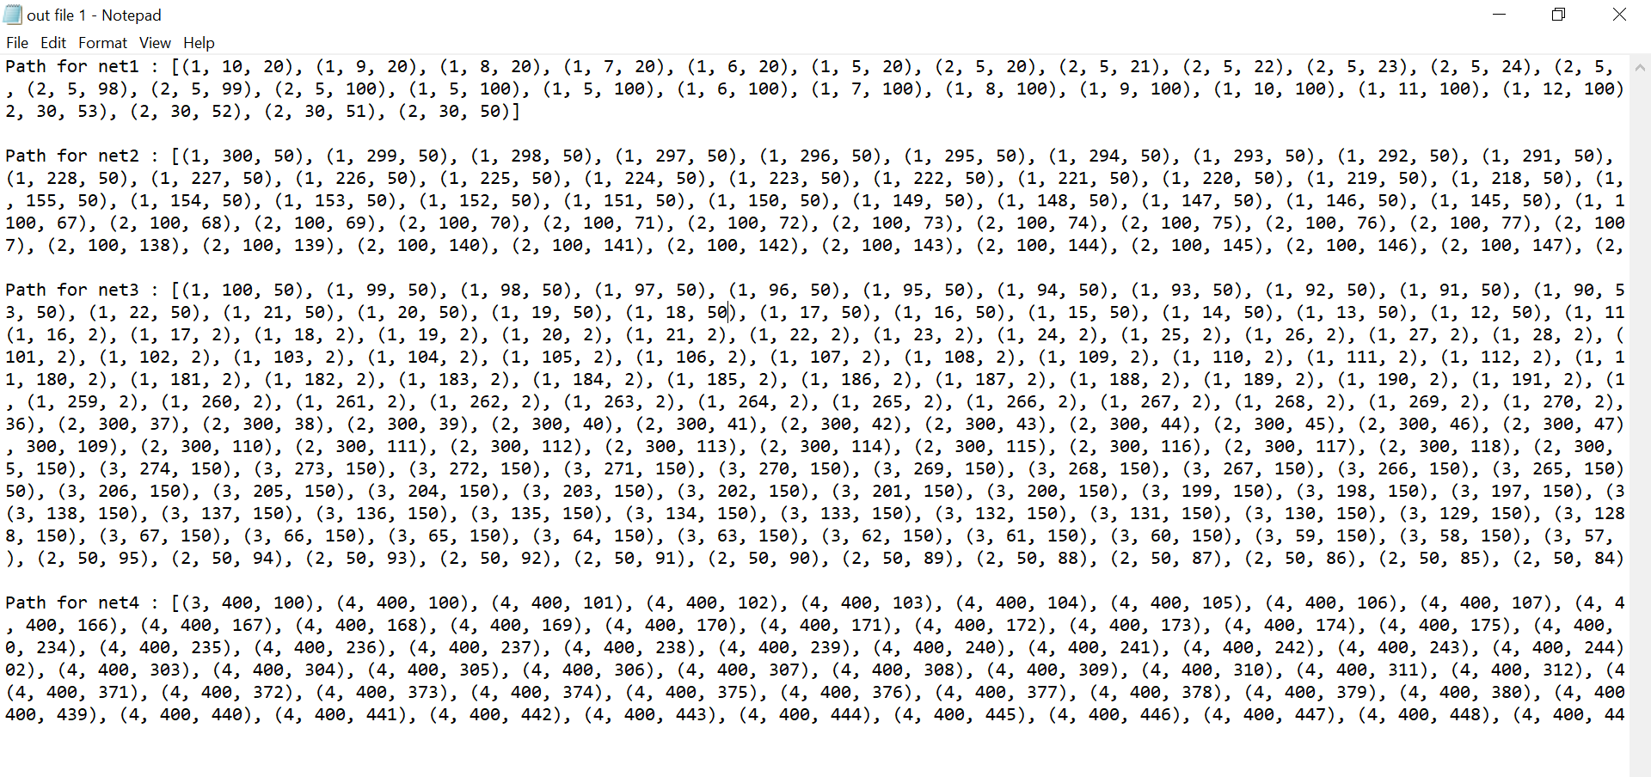
Output
Example of 3d graph and output file format:
This project gives 2 outputs:
Output text file
3D Graph showing the paths
The text file shows the steps taken from each pin to its destination, in the form of:
Path for net_name: [(pinlayer, pinx, piny), (next_pinlayer, next_pinx, next_piny)]

Slide 7
Bonus Feature

Slide 8
Reading DEF and LEF files as Inputs
Before implementing this feature the requirements from the LEF and DEF files had to be realized.
UNITS: units in microns
NETS: is a list in the form of (ComponentName PIN)
COMPONENTS: ComponentModel is obtained by searching ComponentName
MACRO: MACRO is obtained by searching ComponentModel
PIN: PIN dimensions and layer are found under MACRO
DEF file:
UNITS
NETS
COMPONENTS
LEF file:
MACRO
PIN

Slide 9
Reading DEF and LEF files as Inputs
Now that the required data from the files is extracted, it can be transformed to an input to our project. Recall that the input is in the form Net_name (pin1layer, pin1x, pin1y) (pin2layer, pin2x, pin2y)...
Net_name will simply be the Net name beginning at each NET pin1layer will be the layer of the PIN we obtained in the previous slide pin1x|y will be the coordinates of ComponentName divided by UNITS in DEF file + the position of the PIN

Slide 10
Limitations and Assumptions
PIN positions are listed in one or more RECT statements : RECT x1 y1 x2 y2
Only x1 y1are taken from the first RECT statement
The MACRO parsing algorithm jumps to the next MACRO when it finds vdd, gnd, or clk PIN
Therefore vdd, gnd, clk pins must be at the bottom of the MACRO
Due to the simplicity of the input, most of the LEF and DEF file are not used

